Slide 1
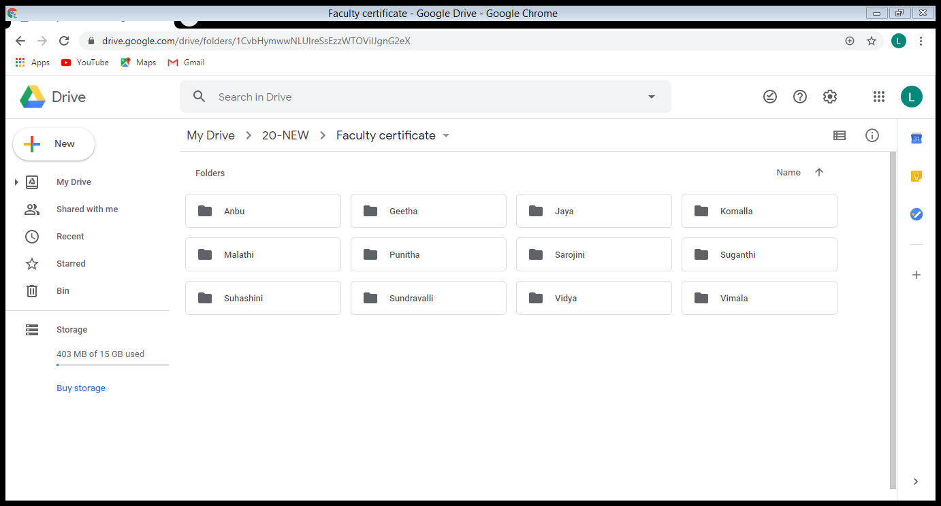
The Physical Layer
UNIT 2

Slide 2
Guided Transmission Media
Magnetic media
Twisted pairs
Coaxial cable
Power lines
Fiber optics

Slide 3
Magnetic Media
Write data onto magnetic media
Disks
Tapes
Data transmission speed
Never underestimate the bandwidth of a station wagon full of tapes hurtling down the highway.

Slide 4
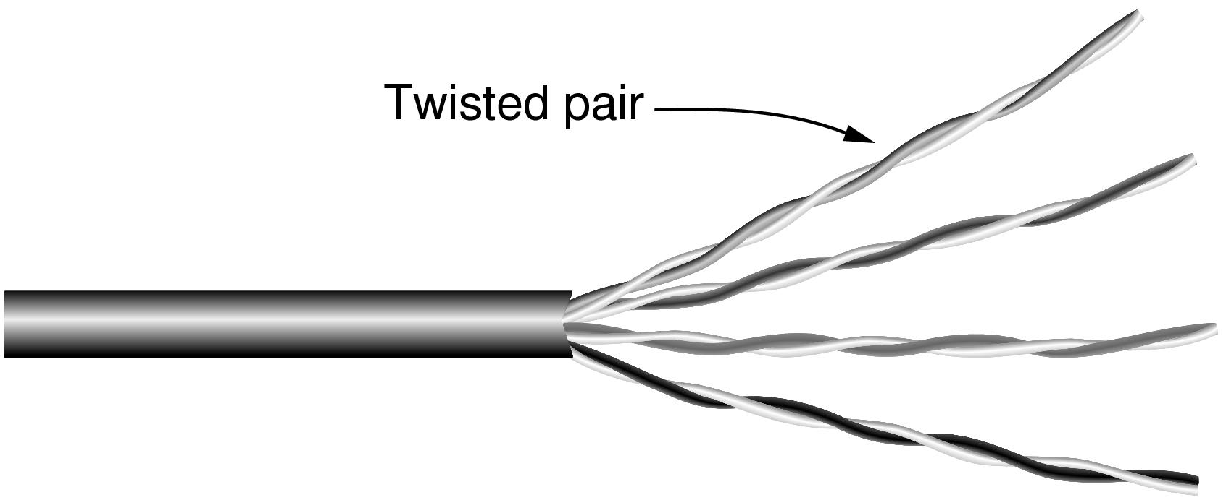
Twisted Pairs
Category 5 UTP cable with four twisted pairs

Slide 5
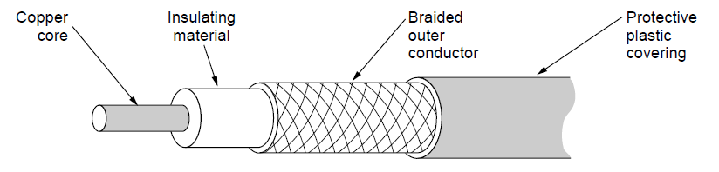
Coaxial Cable
A coaxial cable

Slide 6
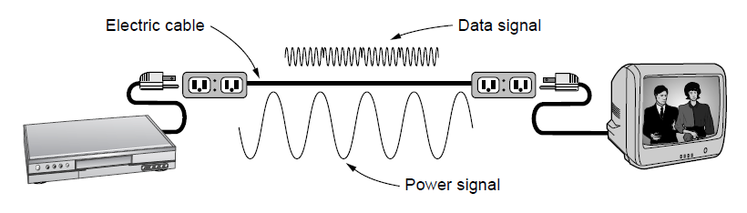
Power Lines
A network that uses household electrical wiring.

Slide 7
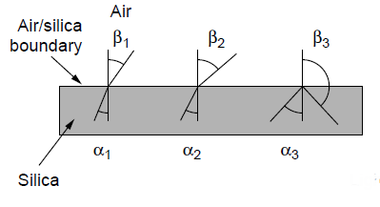
Fiber Optics (1)
Three examples of a light ray from inside a silica fiber impinging on the air/silica boundary at different angles.

Slide 8
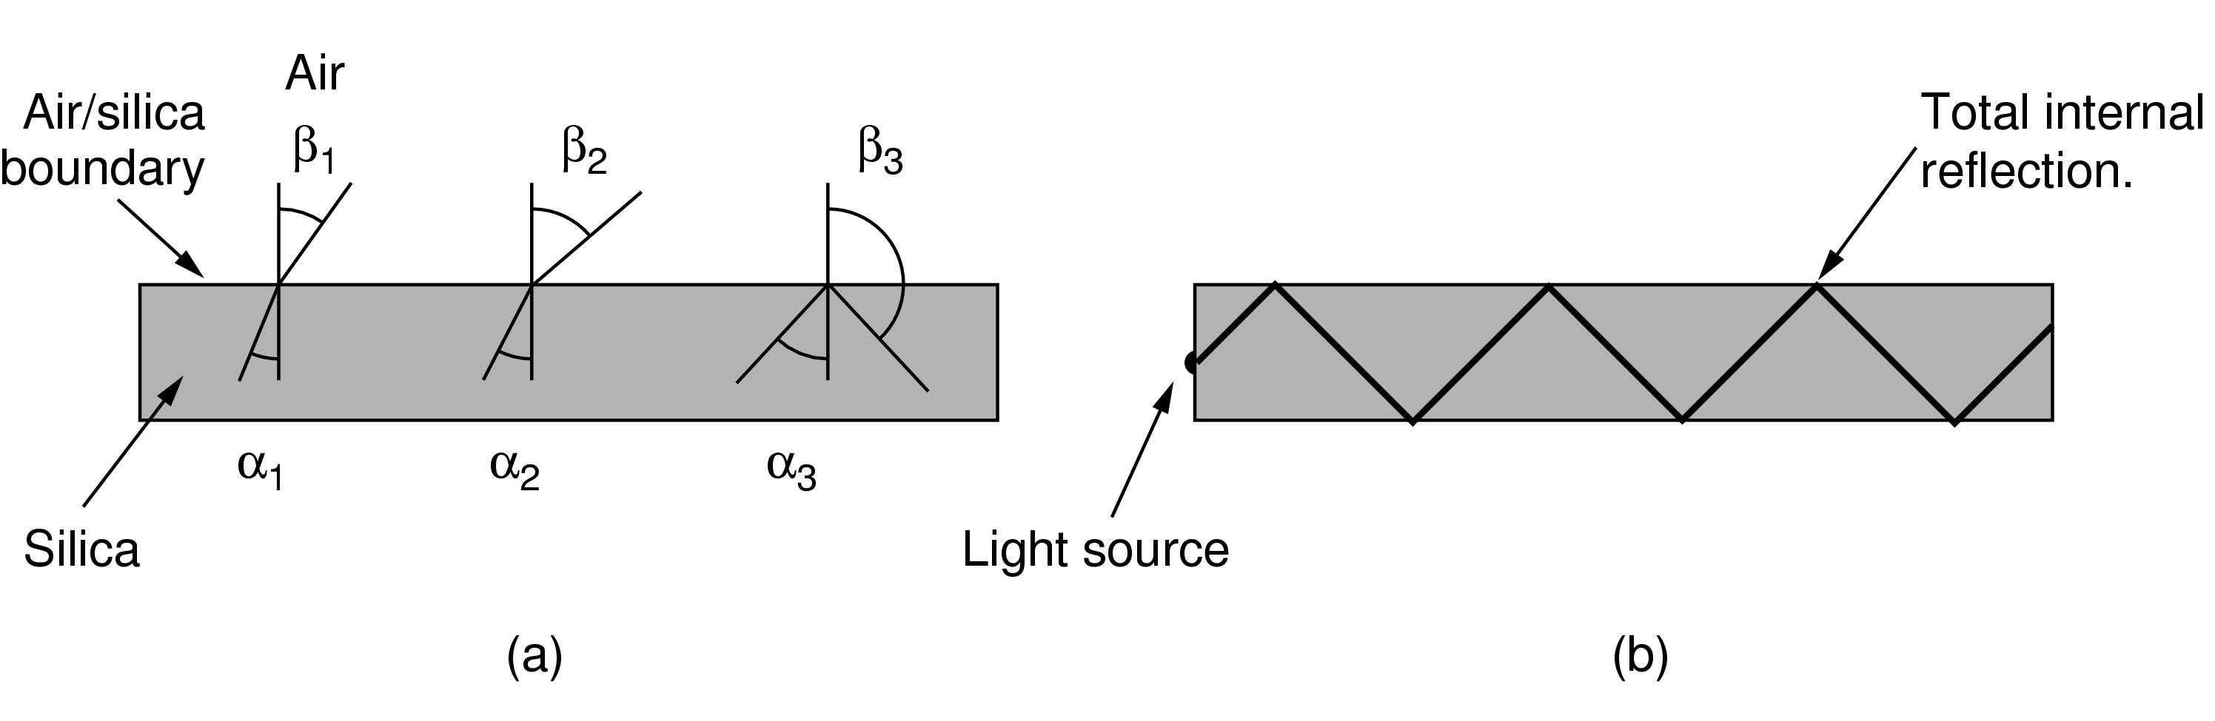
Fiber Optics (2)
Light trapped by total internal reflection.

Slide 9
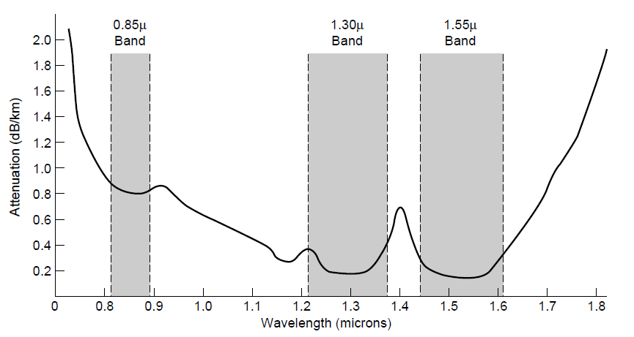
Transmission of Light Through Fiber
Attenuation of light through fiber in the infrared region

Slide 10
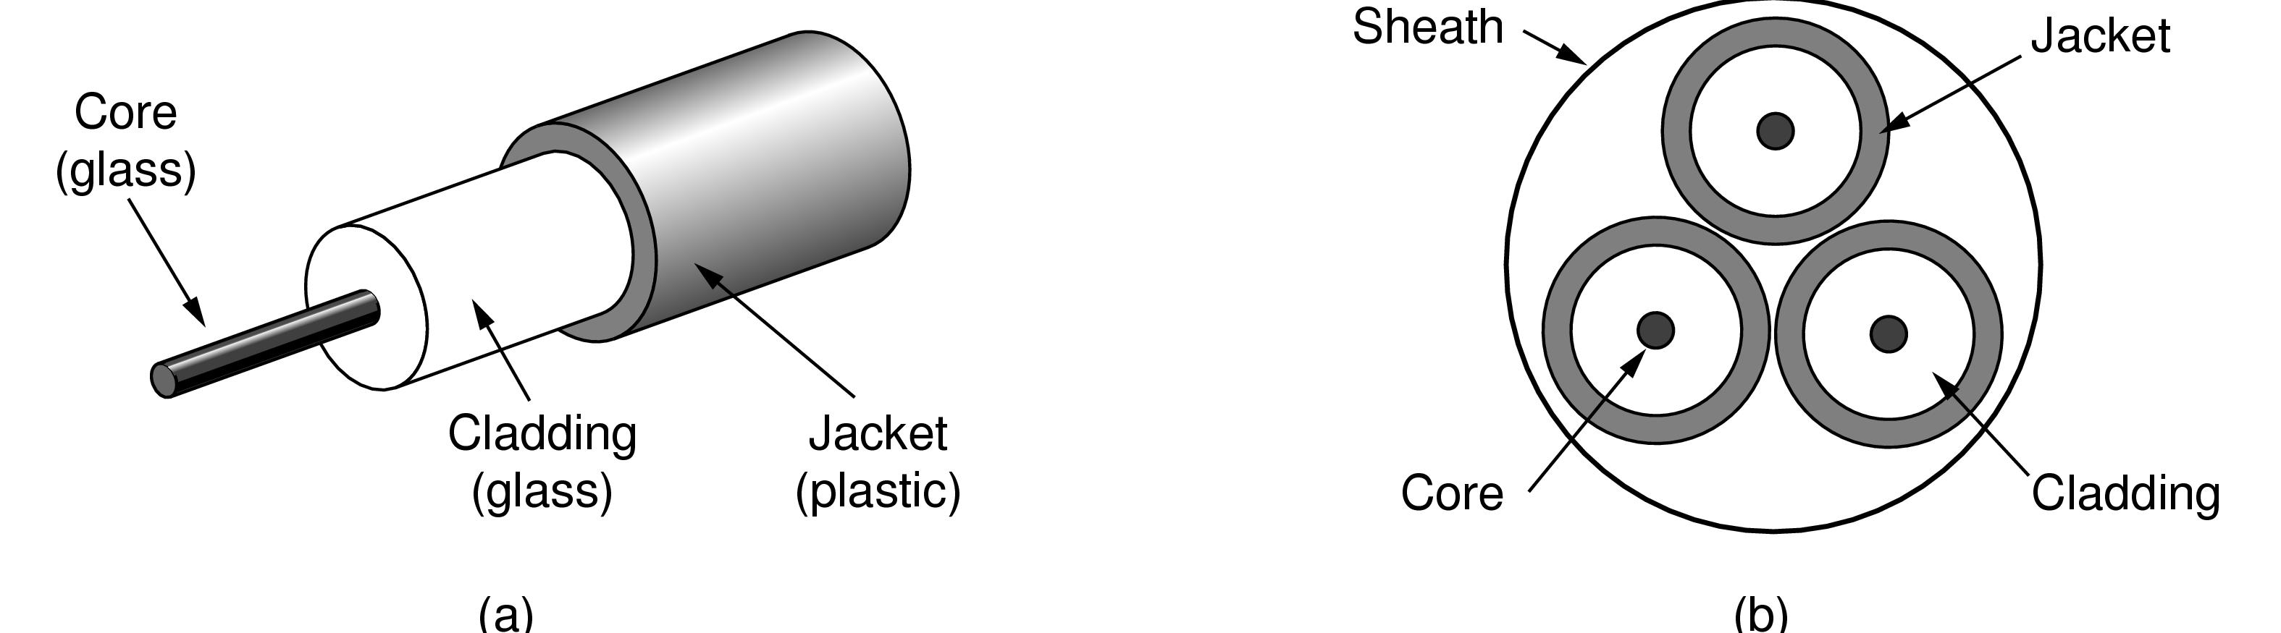
Fiber Cables (1)
Views of a fiber cable

Slide 11
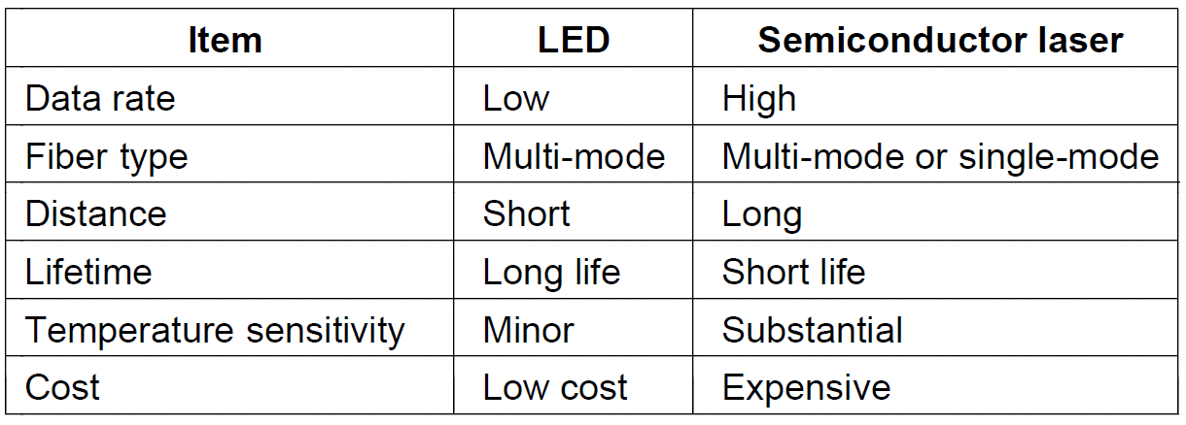
Fiber Cables (2)
A comparison of semiconductor diodes and LEDs as light sources

Slide 12
Wireless Transmission
The Electromagnetic Spectrum
Radio Transmission
Microwave Transmission
Infrared Transmission
Light Transmission

Slide 13
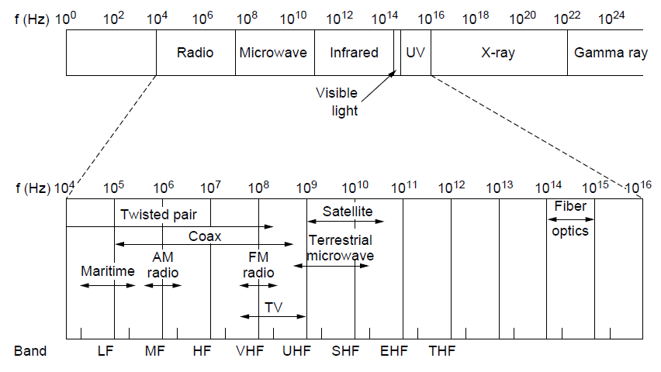
The Electromagnetic Spectrum (1)
The electromagnetic spectrum and its uses for communication

Slide 14
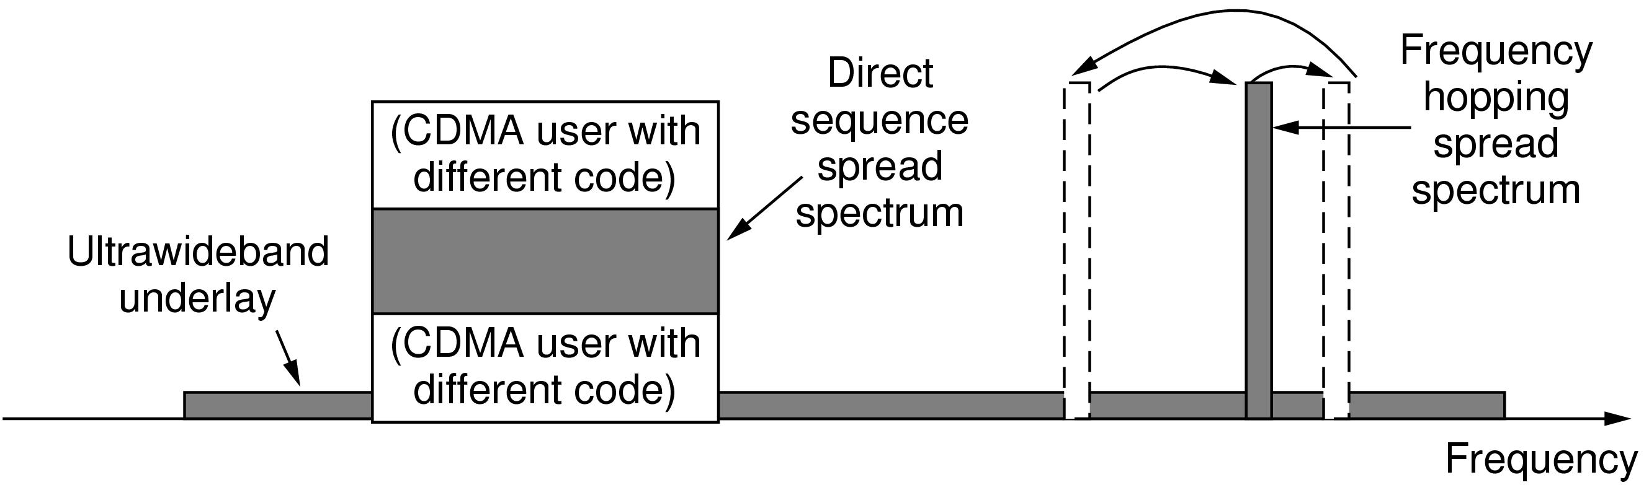
The Electromagnetic Spectrum (2)
Spread spectrum and ultra-wideband (UWB) communication

Slide 15
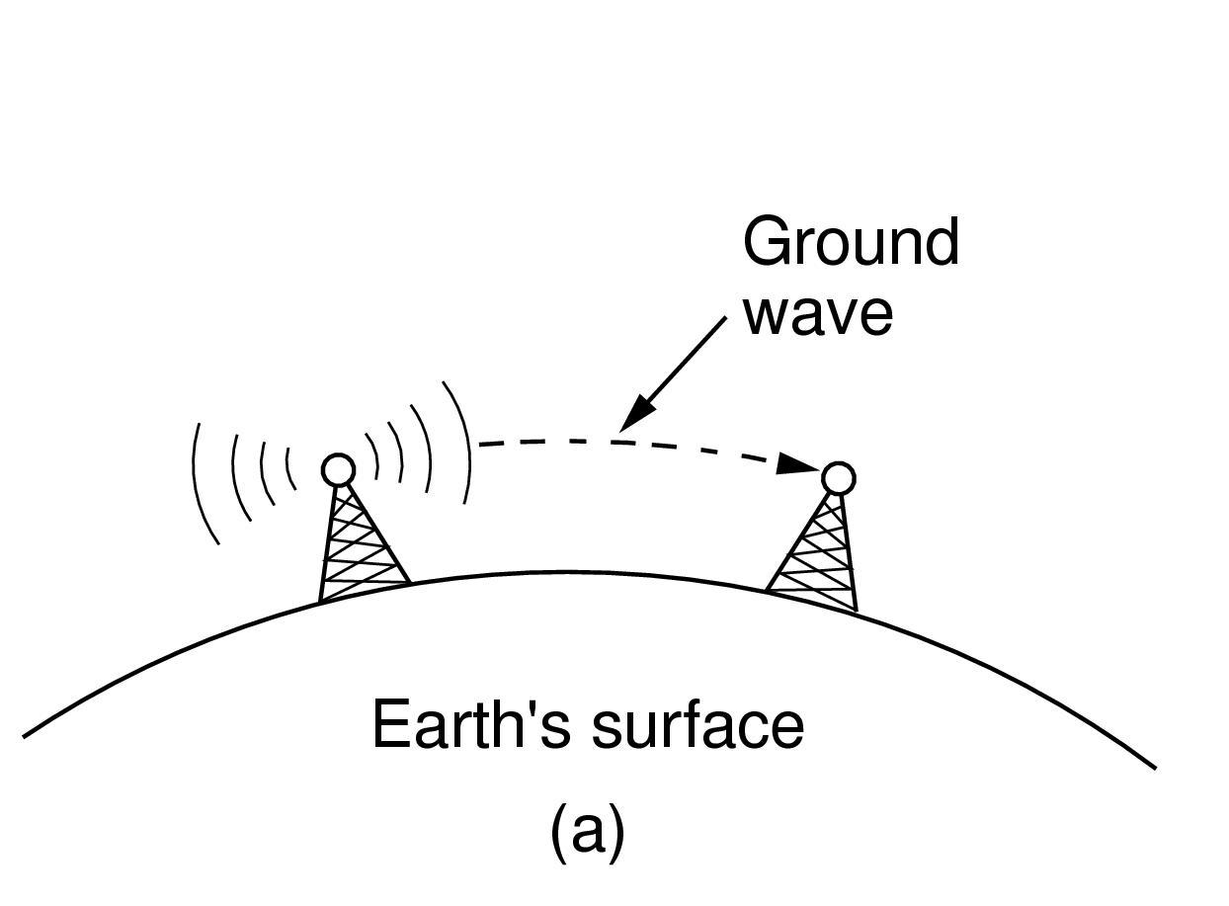
Radio Transmission (1)
In the VLF, LF, and MF bands, radio waves follow the curvature of the earth

Slide 16
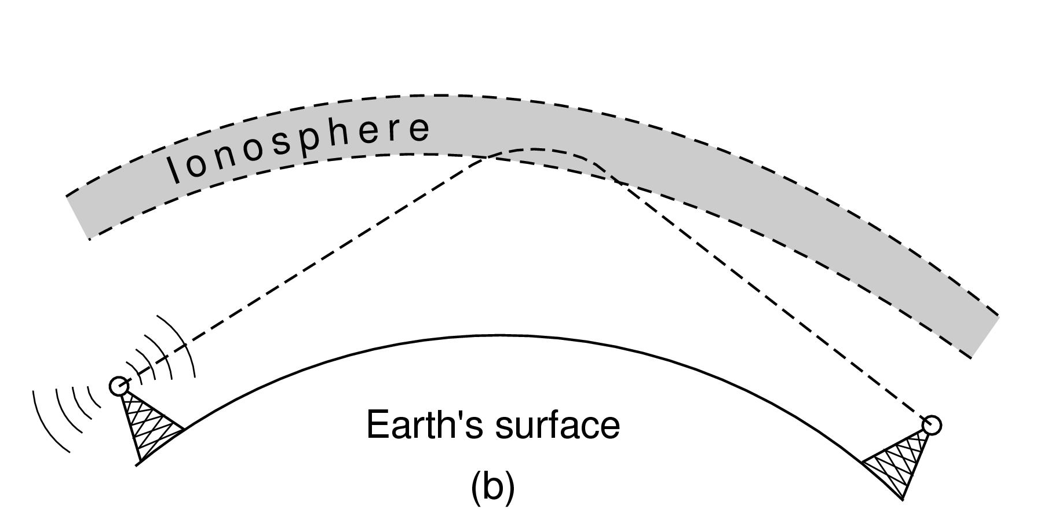
Radio Transmission (2)
In the HF band, they bounce off the ionosphere.

Slide 17
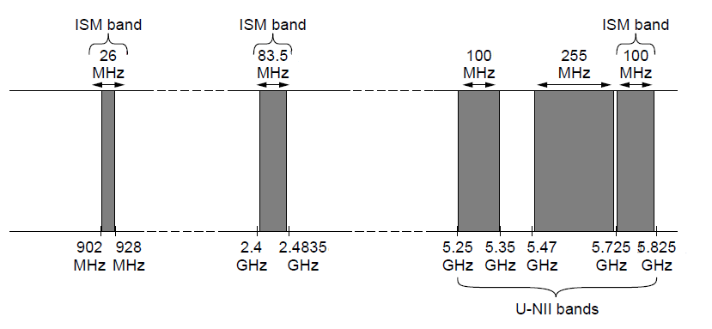
The Politics of the Electromagnetic Spectrum
ISM and U-NII bands used in the United States by wireless devices

Slide 18

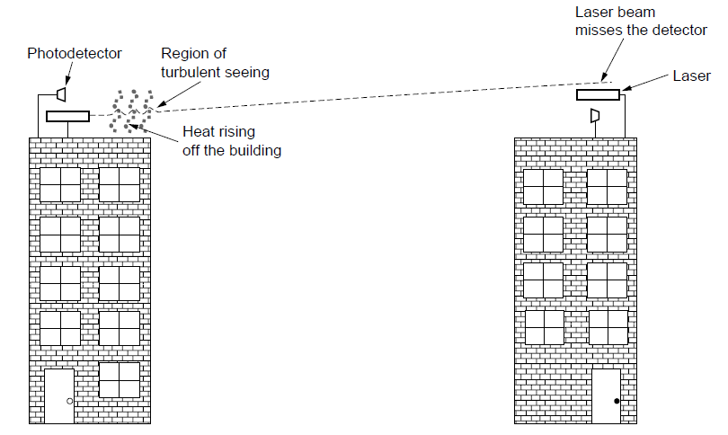
Light Transmission
Convection currents can interfere with laser communication systems. A bidirectional system with two lasers is pictured here.

Slide 19
Communication Satellites
Geostationary Satellites
Medium-Earth Orbit Satellites
Low-Earth Orbit Satellites
Satellites Versus Fiber

Slide 20
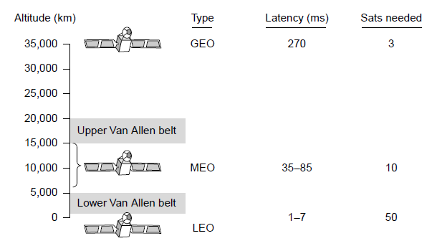
Communication Satellites
Communication satellites, some properties, including: altitude above earth, round-trip delay time, number of satellites for global coverage.

Slide 21
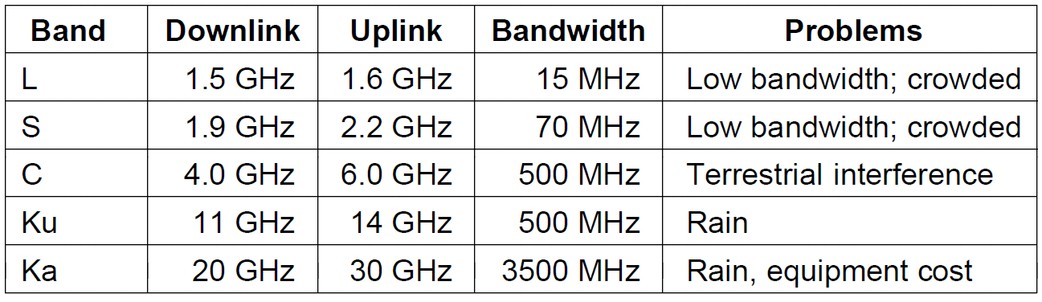
Geostationary Satellites (1)
The principal satellite bands

Slide 22
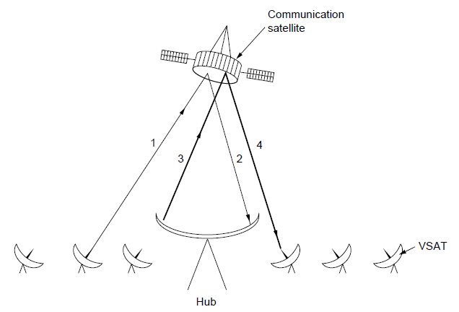
Geostationary Satellites (2)
VSATs using a hub.

Slide 23
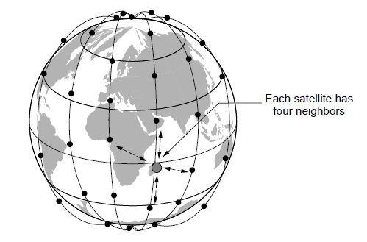
Low-Earth Orbit Satellites (1)
The Iridium satellites form six necklaces around the earth.

Slide 24
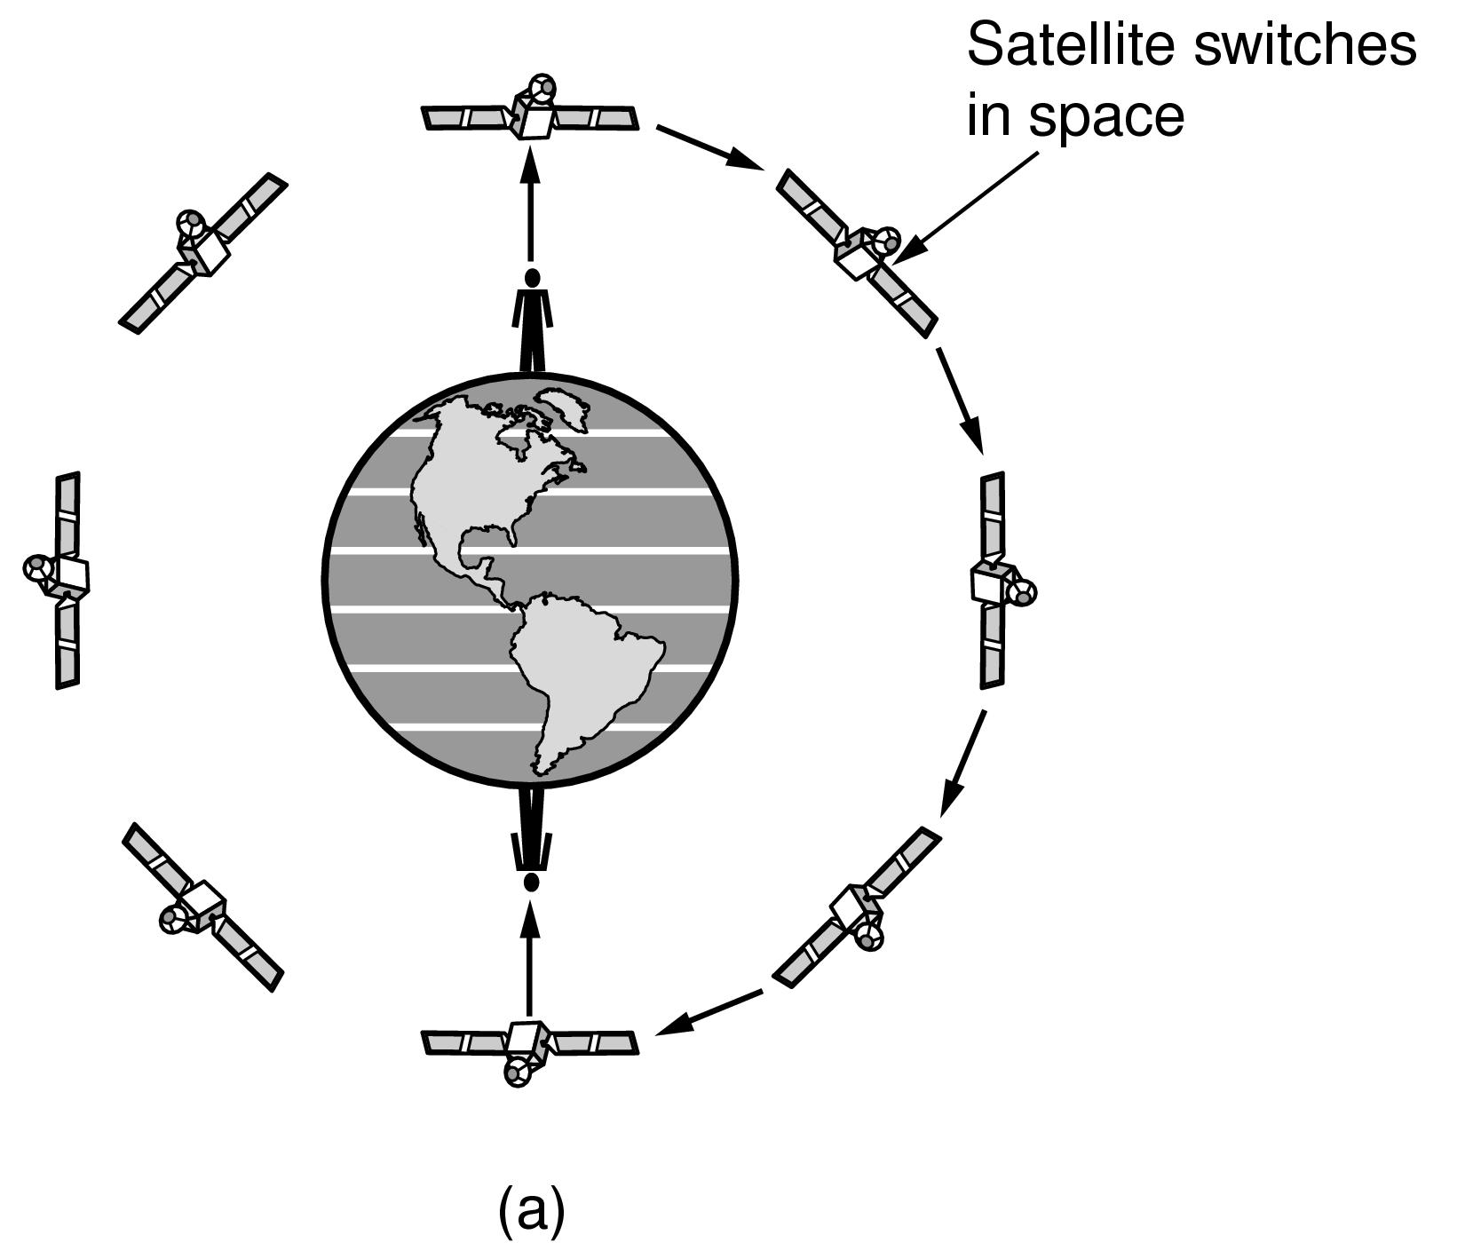
Low-Earth Orbit Satellites (2)
Relaying in space.

Slide 25
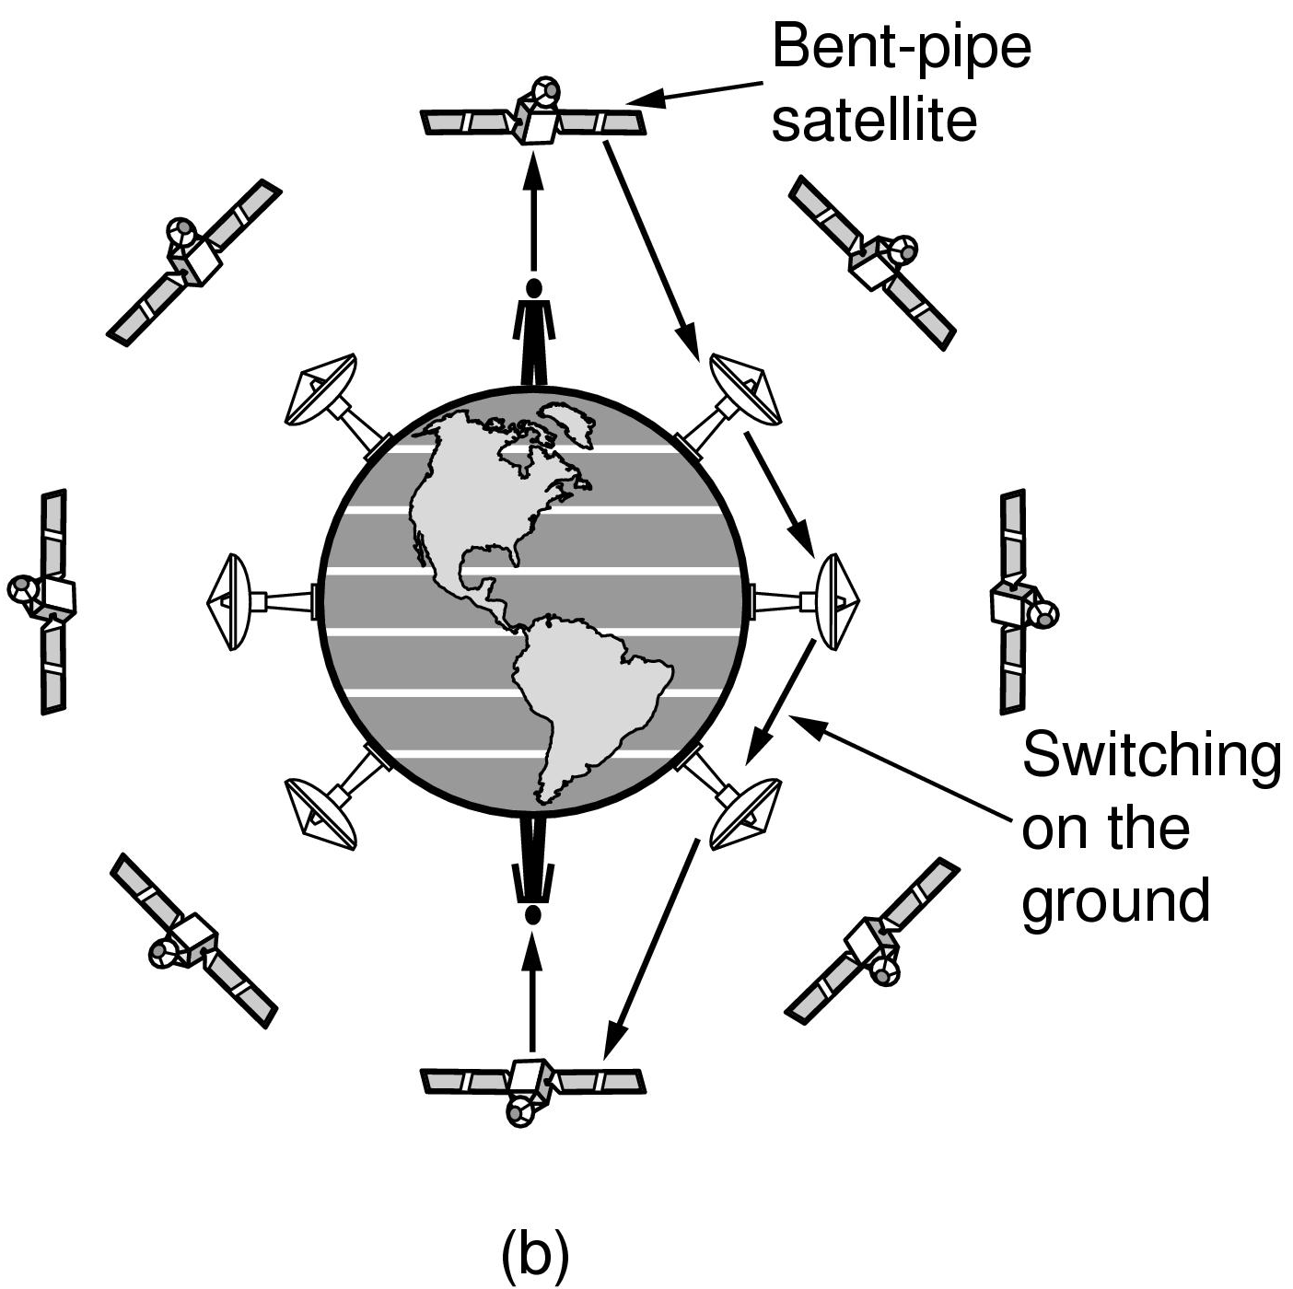
Low-Earth Orbit Satellites (3)
Relaying on the ground

Slide 26
End
Chapter 2

